Slide 1
Section IV: Proximal Operators

Slide 2
Proximal Operators
Notes:
First, I will just outline what a proximal operator is.
CLICK-1
Here is the mathematical definition. The proximal operator returns the point in a convex set that minimizes the distance to a given input point z.
Let me illustrate how this work. First, I need a convex set C
CLICK-2
Observe that the convex set does not need to be smooth. This one has a small cusp on the right side of the boundary. Next, I need an input point z.
CLICK-3
The closest point in C is the point on the boundary with smallest distance to z.
CLICK-4
Let me draw another point.
CLICK-5
This time z is inside the convex set C. The solution x-star is now equal to z. Let me draw one more case.
CLICK-6
This time I observe that there are several input points that will map to the same non-smooth point on the boundary of the convex set.
Next, I will investigate how the non-penetration condition can be rewritten into an equivalent proximal operator model.

Slide 3
Proximal Operators
Notes:
I will just write up the complementarity condition that I use to model non-penetration.
CLICK 1
Here I have that v-n is positive then lambda-n is zero which means contact is breaking,
Or I have that lambda-n is positive then v-n must be zero and and the contact is sustained.
Next, I will just write up the proximal operator model
CLICK 2
It is a fixed-point problem.
The complementarity problem and the fixed-point problem has the same solutions as I will prove shortly.
Observe here that two new things popped up. The convex set N that consists of all the non-negative numbers. It is not hard to see the relation between the N-set and the unilateral constraints on v-n and lambda-n. However, the positive scalar r-n is not as obvious. It works as a regularization parameter and has no impact on the solution. It is easy to see that if I multiplied v-n in the complementarity problem with r-n then I just rescaled v-n but did not change its sign.
Now where I have built this intuition. I can go more into showing the details of this.

Slide 4
Proximal Operators
Notes:
To get to the deails I will just do a case-by-case analysis. Let me start with the convex set N
CLICK 1
I will assume that lambda is positive
CLICK 2
If v-n is positive, then lambda-n minus r-n times v_n must be on the left of lambda-n
CLICK 3
On the other hand, if v-n is negative the lambda-n minus r-n times v-n will on on the right of lambda-n
CLICK 4
Looking at the proximal operator model I can now see that only if v-n is zero then I have a solution for this model. This holds for any positive value of r-n.
Next, I will consider the case of lambda-n equal to zero.
CLICK 5
As before I will consider two possibilities of v-n being positive and negative.
CLICK 6
I notice that in the positive case the proximal operator will return zero whereas in the negative case I have a point inside my convex set N.
CLICK 7
So, I conclude that the proximal operator model can only hold if v-n is positive.
This concludes my case-by-case analysis, I have shown that the solutions for the proximal operator are the same as the complementarity problem condition.
This took care of the normal force part I will next describe how friction can be rewritten into a proximal operator model.

Slide 5
Proximal Operators
Notes:
For the friction forces I have some friction cone that describes all feasible friction forces, and I have some relative sliding velocity v-t.
I illustrate the friction cone here as a limit surface drawn in the contact plane spanned by the x and y axis. For now, I assume normal forces is some fixed value.

Slide 6
Proximal Operators
Notes:
The friction force will oppose the sliding motion.
This means the friction force will be in the half-space pointing a way from the sliding velocity.
This means the instantaneous power of the friction force will be negative. That means friction is dissipating energy.

Slide 7
Proximal Operators
Notes:
Principle of maximum dissipation says the friction force solution will be the friction force that dissipates most energy.
This is the force that are mostly in opposite direction of v-t.
Observe that the friction force may not be directly opposing v-t as shown in the example here.

Slide 8
Proximal Operators
Notes:
A different way to look at this is to look at the difference between two friction values. Here gamma-t and lambda-t.
If lambda-t is more dissipative then the difference of the two friction forces dotted with v-t will be positive.
As the example shows the green arrow being the force difference and the sliding velocity vector makes a positive dot product.

Slide 9
Proximal Operators
Notes:
This means that for lambda-t to be most dissipative then the difference vector with all other possible feasible friction forces must make a non-negative dot product with the sliding velocity.
This mathematical form is known as a variational inequality.
To get to the proximal operator model I make the observation that all those green vectors will be in the tangent cone at lambda-t.

Slide 10
Proximal Operators
Notes:
So let me just draw the tangent cone here explicitly to make that connection clearer.

Slide 11
Proximal Operators
Notes:
The tangent cone is characterized by having minus v-t as its normal cone.
This means that if I shoot out a ray from lambda-t in the direction of the normal cone then any point on that ray will have lambda-t is the closest point in the friction cone.
This gives me the connection to the proximal operator model for friction.
Notice here that the r-value is basically the ray-length of the point that will have lambda-t as closest point. Any positive r-value will have the same lambda-t as solution.

Slide 12
Proximal Operators
Notes:
I have now explained how non-penetration constraints and friction forces each are modelled with a proximal operator. I will now combine these two models into one model.
CLICK-1
The result look likes this. The nice thing about the r-values is that they do not influence the solution. The r-values affect the convergence constant. I wll demonstrate how later on. For now, I am happy to notice that the combined model is a fixed-point problem. I can think of the right-hand side as some non-smooth function that I here just call F. This first combined version of the proximal operator model already reveals a few beautiful traits. Notice that the “physics” goes straight into the mathematical model without any need for discretization of for instance the friction cone. It is a model that stays very close to the underlying principles.
The current vesion does not quite reveal all the nasty coupling that goes on, so I will write out dependencies a little more by using the fact that the relative contact velocities is an affine transformation of the contact impulses.
CLICK-2
Now the fixed pint formulation looks like this. Observe how lambda-t is coupled into the normal part through the A-N F sub-block, similar for the friction part the lambda-n is coupled by the A-F N sub-block. However, there is a third coupling too, notice that lambda-n is also an input parameter to the friction cone. When I solve the proximal operator model, I must consider all these couplings between the variables.
Currently I will without loss of generality just pose the model for a single point of contact to avoid cluttering up the math with a lot of indices. Extending to N contacts means that I will have N such simultaneous equations and the A sub-blocks will create couplings between different contacts too.

Slide 13
Proximal Operators
Notes:
I will now extend to N contacts. I will do this by using this z-vector short-hand notation
CLICK 1
for lambda minus R times A times lambda plus b.
Here R is now a matrix that collects all the r-values. Using this short-hand we get K equations of this form
CLICK 2
Solving this large fixed-point problem can be done by a fixed-point iteration.
CLICK 3
Here is one example of how this can be done. I put lambda values from iteration k into the right hand-side and use the proximal operator to compute an updated lambda-value for the k+1st iteration. I will continue looping until the difference in lambda values suggest I am converging to a fixed point.
There are two typical variations on how to update the z-values and the friction cones. One version solves all contacts simultaneously and use lambda values at the k-th iteration to compute all z-values and friction cones simultaneously before solving all proximal operators simultaneously too. This is a nice embarrassingly parallel process. I call this a Jacobi scheme. The version I showed here assume normal forces are solved before friction forces and hence I use the most updated normal force for generating the friction cone. One can extend the idea of using the most updated values as soon as they are available. This means one solves contacts one-by-one and update the z-values accordingly to always have the most updated version. This I call a Gauss-Seidel scheme.
I have now introduced the basic idea of the numerical method for solving the proximal operator model. I am now ready to go into a little more detail.

Slide 14
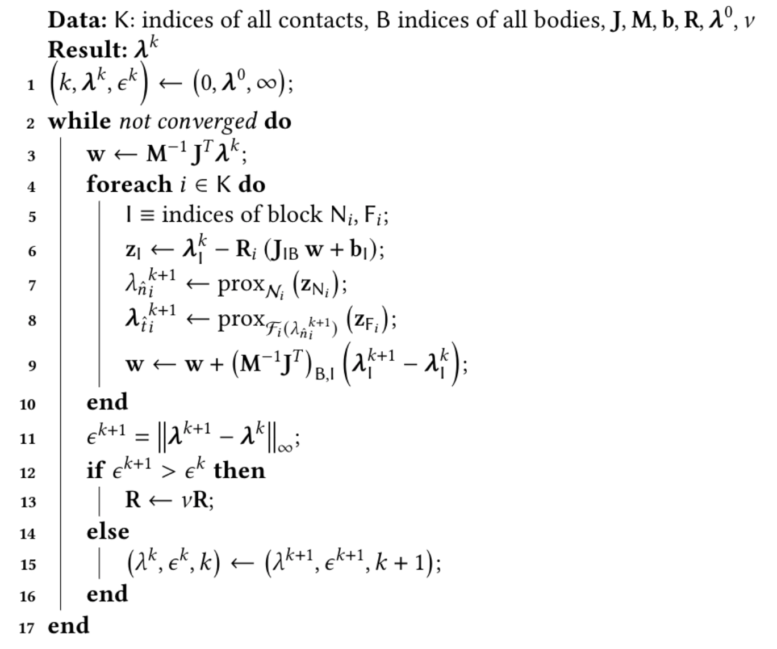
Proximal Operators
Notes:
Here I have shown the final Gauss-Seidel scheme of the proximal operator method using an adaptive r-factor strategy.
Observe that there is a two-loop structure to the algorithm. The inner loop takes one sweep over all contacts and for each contact it first solves the normal-part of the proximal operator model and then it solves the friction part afterwards.
The outer loop continues doing these sweeps over all contacts until I have converged to a fixed point. However, there are some details to this algorithm that needs a little more explanation.
CLICK 1
The first detail that pops up is this w vector that I use to compute the z-vector value before giving it as input to the proximal operators. What goes on here is that I exploit a factorization of the coefficient matrix A.
CLICK 2
Recall this affine equation
CLICK 3
The A-matrix is given by the Jacobian times the inverse mass matrix times the Jacobian transpose.
CLICK 3
If I just add a parenthesis here and call this term w then the connection to the two red boxes is quite clear. However, I update the w vector right here
CLICK 4.
That is just after I know how I changed the lambda values for the i’th contact then I go in an immediately update the w-vector. This is computational cheaper than doing a full recompute like the one I did in the top red box.
I am now done with the sweep over the contact points. The next thing that happens is a convergence test in line 12 of this algorithm.
If I detect divergence, then I will reduce the r-values
CLICK 5
If the scheme is converging, I will accept the new iterate
CLICK 6
This is the most-simple way to control the r-values. Other schemes can be used. The important thing to remember is that for smaller values I am guaranteed to converge, but it goes slower, for larger values it goes faster, but I risk divergence.

Slide 15
Proximal Operators
-v
r
Notes:
I will now show an example of how the fixed-point iteration work on the proximal operator model. I start with a convex set that is a blue disk. The initial iterate is shown by the yellow dot.
CLICK
Then I move the distance r in the minus v direction to get the new z-vector that is input to the proximal operator. I have marked this here with a red dot.
CLICK
The solution of the proximal operator gives me the closest point on the blue disk. This is the next iterate in the fixed-point iteration.
CLICK
I repeat the steps now
CLICK
And I get the next iterate
CLICK CLICK
and the next
CLICK CLICK
and the next
CLICK CLICK
and the next. It is obvious that if I continue this way I will end up very close to the north pole of the blue disk. This is the point on the disk were minus v will be in the normal cone.

Slide 16
Proximal Operators
Notes:
Using the example, I can now investigate the effect on the fixed-point iteration when I change the r- value.
Here on the left I have displaced the iterates as the algorithm moves from positive x-axis to the north pole. I re-scaled the trajectories, so they are plotted on a disk with a radius equal to the r-value. This is just so the plot will not clutter up and we better can compare how fast each r-value moves towards the north pole.
I observe that for small r-values I get many iterates while for larger r-values I get less iterates.
A different way to analyze this is to measure the fixed-point residual and take a log plot of this error measure. This is shown on the right. Clearly for this example I have linear convergence rate, and I see that the r-value is directly related to the convergence constant. Using larger values goes faster.
This little analysis show the tendencies clearly, try to use a large r-value is better. However, the example does not show what happens if the r-value gets too big. In this case the fixed-point iteration may diverge. Hence, it is non-trivial to figure out what the optimal r-value is.
Hence, I proposed in the Gauss-Seidel scheme I presented to adaptively change the r-value. The idea was to test if the scheme is convergent or divergent. If it is divergent then the r-value is decreased until convergent behavior is obtained. Although I did not show it one could increase the r-value if for instance one have experienced convergent behavior for many consecutive iterates.

Slide 17
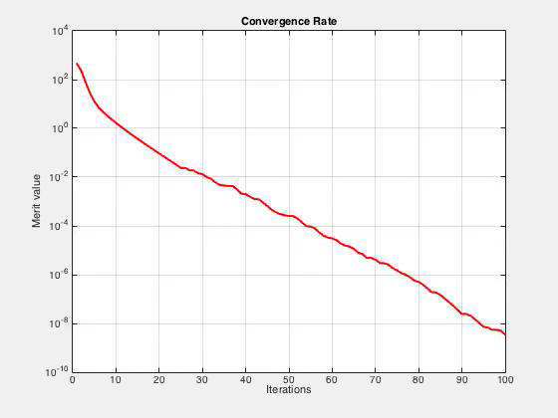
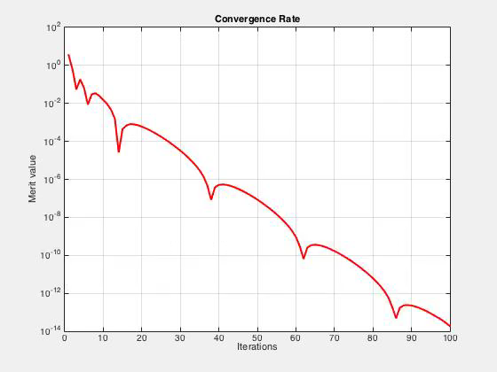
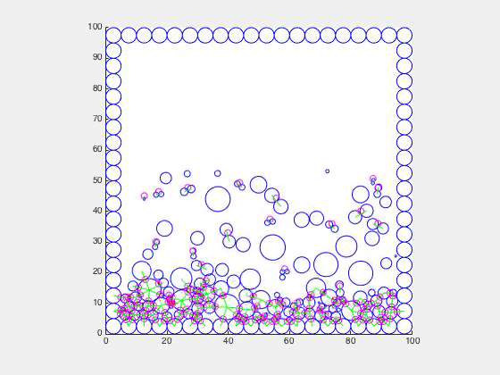
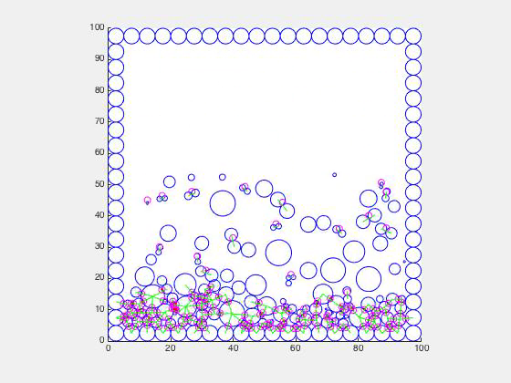
Proximal Operators
Adaptive r-Factor
PSOR (1.4)
Notes:
Let me just show an example that is slightly more complex than the blue disk.
Here I have created a little ball simulator, there are no friction forces in this simulator. Only non-penetration conditions is handled. I will compare an adaptive r-factor strategy for the proximal oprator against the classical projected successive overrelaxation method, known as PSOR. I tuned by hand the relaxation parameter for PSOR to work well.
While the simulations run, I plot the convergence rate of the two solvers so I can have a side-by-side view comparison.
CLICK
There are many interesting observations to make from watching these small videos. First of all, PSOR is not monotome decreasing, sometimes it behaves erratic and may even diverge a bit. The PROX Gauss-Seidel scheme is clearly always strictly decreasing and often gets to a smaller error. Eventhough the two simulations have the exact same initial conditions it is clear that the simulation outcomes are different. Hence, it really matters what type of solver one uses and how accurate the forces are solved for.
The last observation I will make here is that adapting the r-value seems to give me a convergence rate that are super linear. This can also be observed in more complex 3D simulations. So the conclusion I draw from this is that it can really pay off to adaptively change the r-value.

